Slide 1

Heart Disease UCI
Finding the Important Variables to find the Heart Disease and Predicting the Heart Disease
By,
Surya Das

Slide 2
These packages Required
library(caret)
library(ggplot2)
library(MASS)
library(car)
library(mlogit)
library(sqldf)
library(Hmisc)
library(aod)
library(BaylorEdPsych)
library(ResourceSelection)
library(pROC)
library(ROCR)
library(caTools)
Setting the working directory
setwd("E:\\Assignment\\semester2\\machine learning\\linear")
# Reading data; just change the file path to fetch the data.
data <- read.csv("heart.csv")

Slide 3
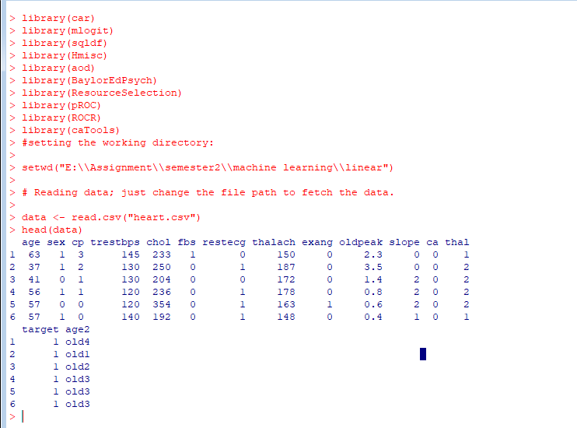
See the Dataset in R (first 6 rows)
head(data)

Slide 4
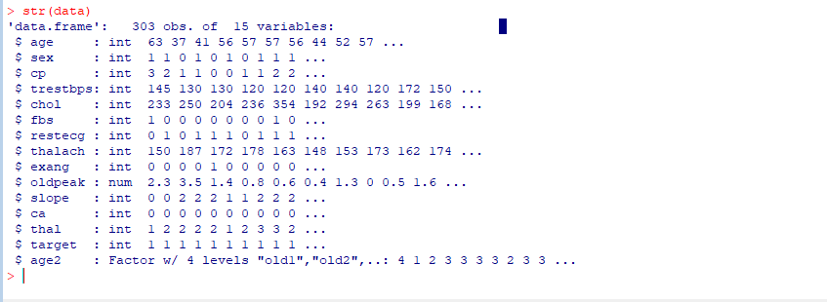
Structure of Dataset

Slide 5
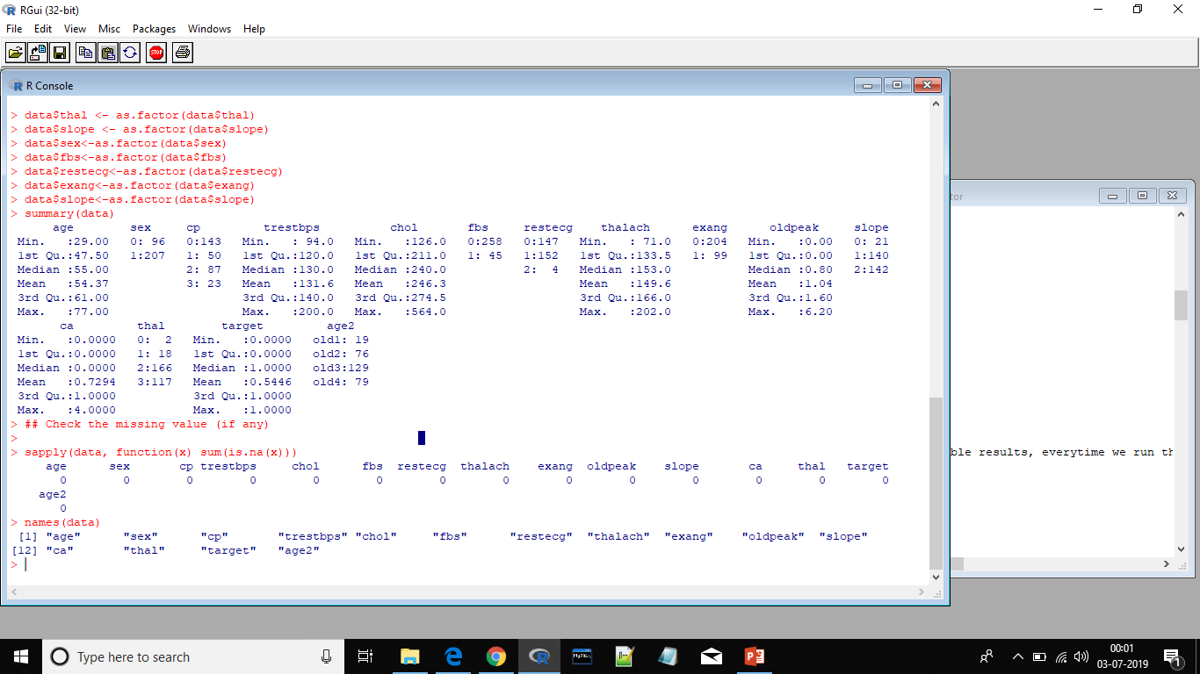
Names of the Columns:
Converting necessary variables into factor
data$cp <- as.factor(data$cp)
data$thal <- as.factor(data$thal)
data$slope <- as.factor(data$slope)
data$sex<-as.factor(data$sex)
data$fbs<-as.factor(data$fbs)
data$restecg<-as.factor(data$restecg)
data$exang<-as.factor(data$exang)
data$slope<-as.factor(data$slope)

Slide 6
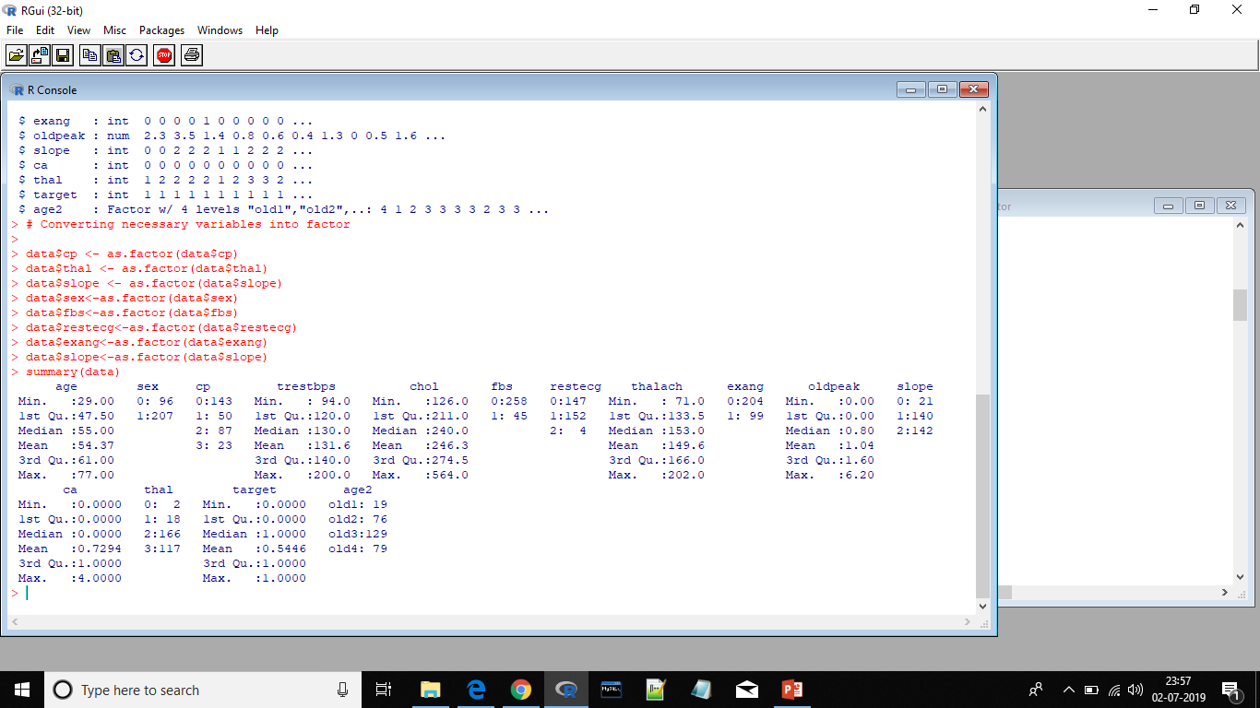
Descriptive Analysis
Check the missing value (if any)
sapply(data, function(x) sum(is.na(x)))

Slide 7
Splitting the Data into 80:20 ratio
set.seed(122)
spl = sample.split(data$target, 0.8)
data.train = subset(data, spl == TRUE)
data.test = subset(data, spl == FALSE)
dim(data.train)
Dim(data.test)
Logistic Model on Training Dataset:
model <- glm(target~sex+cp+trestbps+I(restecg=="1")+thalach+exang+oldpeak, data=data.train, family=binomial())
summary(model)

Slide 8
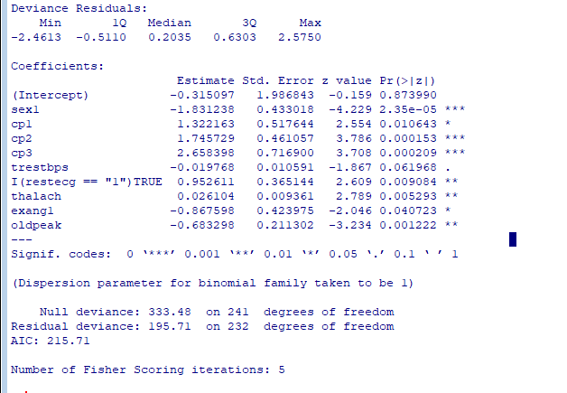

Slide 9
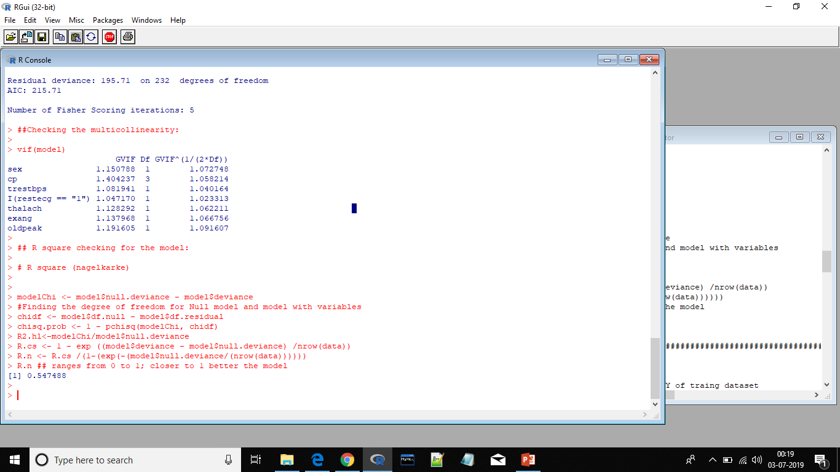
Checking the multicollinearity:
vif(model)
R square checking for the model (nagekarke)
# R square (nagelkarke)
modelChi <- model$null.deviance - model$deviance
#Finding the degree of freedom for Null model and model
with variables
chidf <- model$df.null - model$df.residual
chisq.prob <- 1 - pchisq(modelChi, chidf)
R2.hl<-modelChi/model$null.deviance
R.cs <- 1 - exp ((model$deviance - model$null.deviance) /nrow(data))
R.n <- R.cs /(1-(exp(-(model$null.deviance/(nrow(data))))))
R.n ## ranges from 0 to 1; closer to 1 better the model

Slide 10
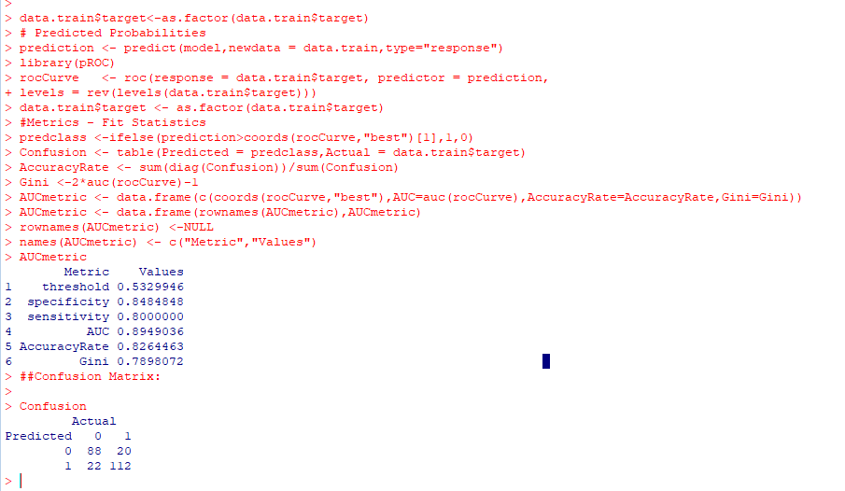
Checking the AUC,GINI,CONFUSION MATRIX,ACCURACY on training dataset

Slide 11
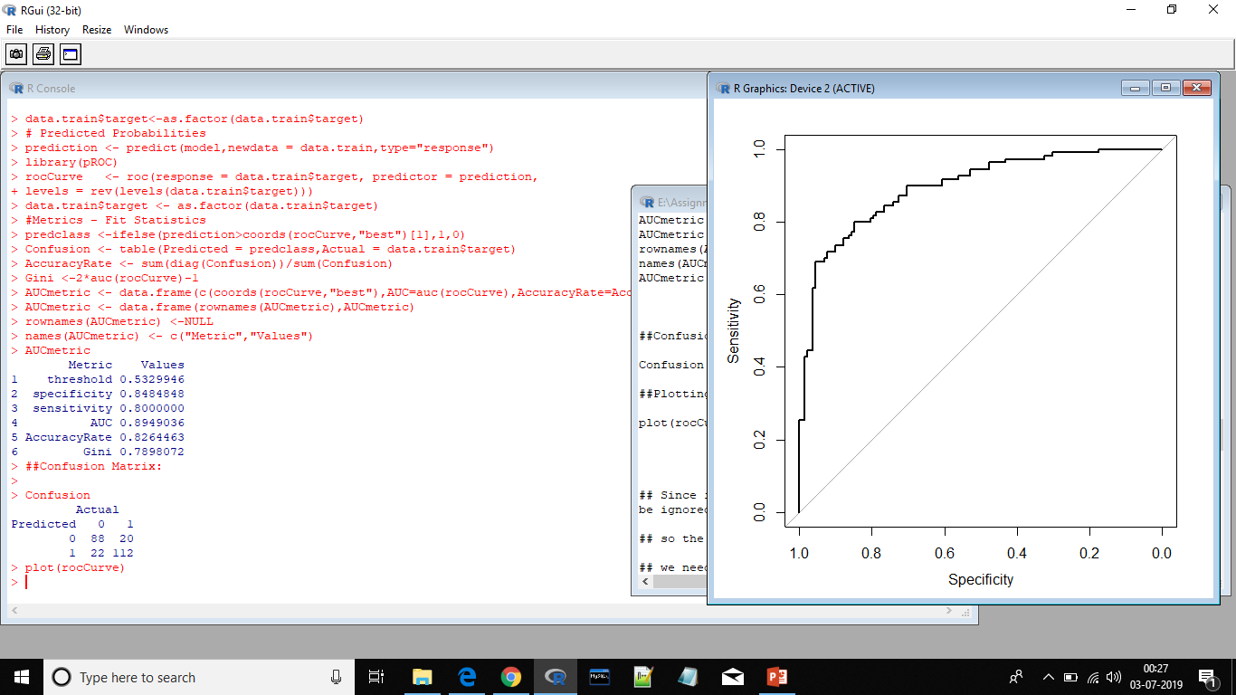
Plotting ROC Curve:

Slide 12
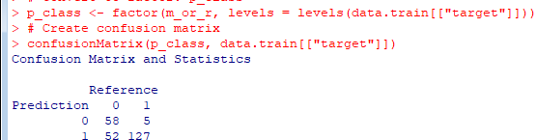
Since it is heart disease dataset so the error rate of heart disease patient shouldn't be ignored:
so the false positive rate should be minimum as possible:
we need to change the threshold value to low:

Slide 13
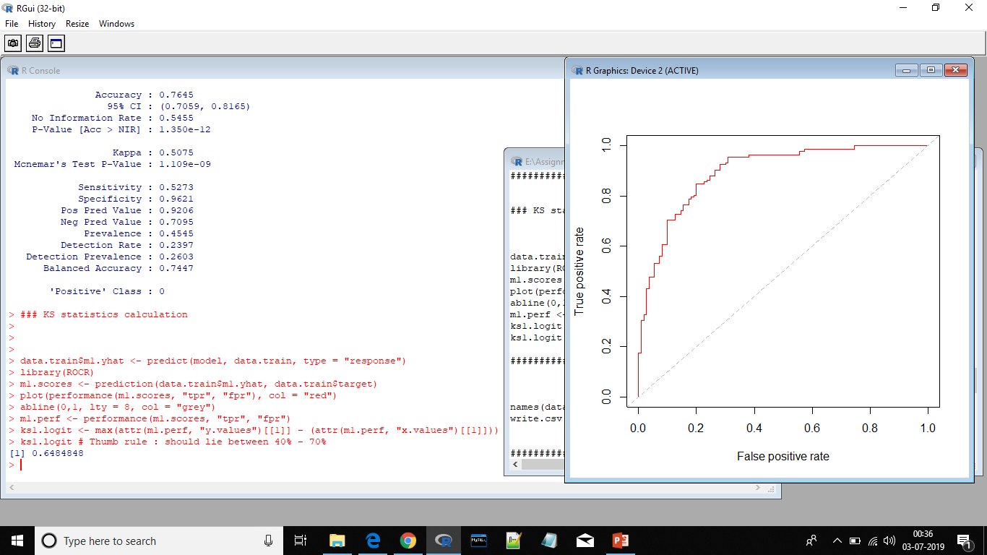
KS statistics calculation

Slide 14
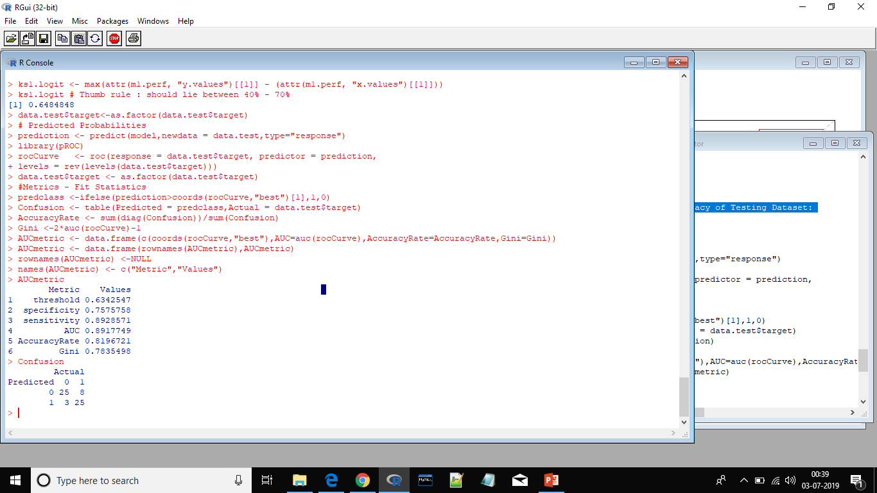
Checking the model on testing dataset:
Checking the AUC, GINI, Confusion Matrix, Accuracy of Testing Dataset:

Slide 15
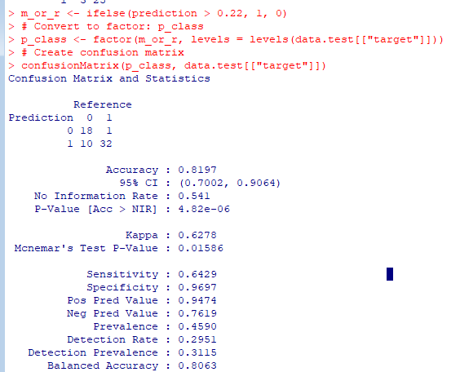
Lowering the False Positive Rate of Testing Dataset:

Slide 16
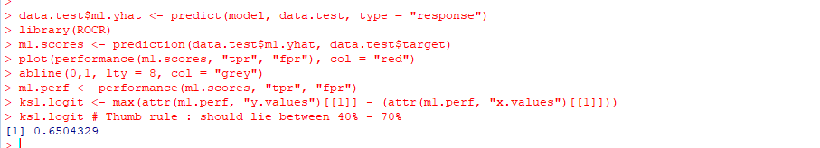
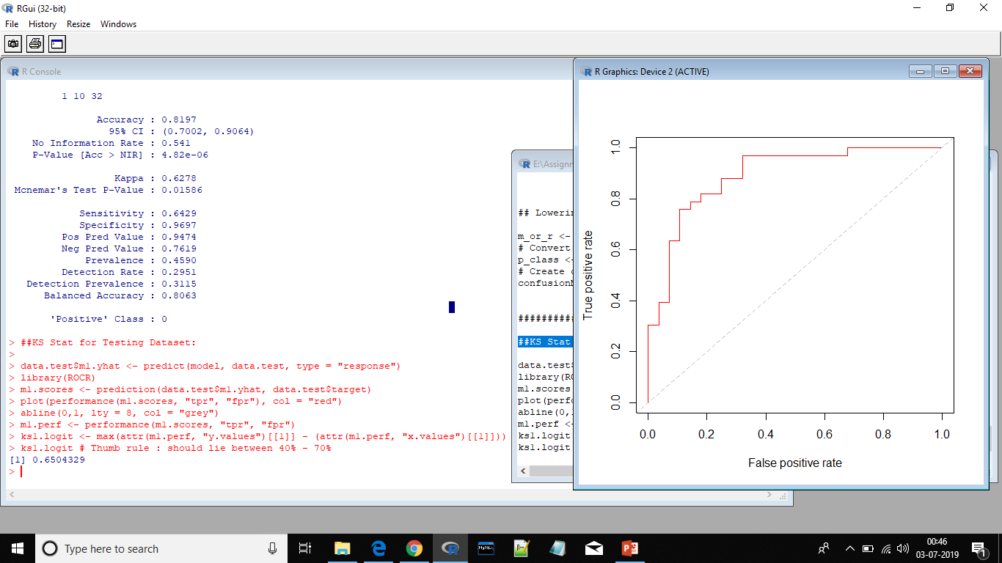
KS Stat for Testing Dataset:

